Slide 1
PERÚ CONVENTION ON CLUSTER MUNITIONS ARTICLE 3 EXTENSION REQUEST SUBMITTED BY THE REPUBLIC OF PERÚ
LT COL FAP JHON BONIFAZ ARISTA

Slide 2
SUMARY
BACKGROUND
ACHIEVEMENTS
DRAFT PLAN
MEASURES TAKEN
CHALLENGES
WHY THE EXTENSION IS REQUESTED

Slide 3
BACKGROUND
676 CLUSTER MUNITIONS REPORTED AT THE ENTRY INTO FORCE OF THE CCM
NOMENCLATURA | REPORTADAS CONVENCIÓN | CANT. SUB MUN.
RBK 500 AO-2,5 RT (60 SUB. MUN. C/U) | 198 | 11,880
RBK 250-275 AO-1SCH (150 SUB. MUN. C/U) | 388 | 58,200
BME 330 SNA (180 SUB. MUN. C/U) | 90 | 16,200
TOTAL | 676 | 86,280
1331 CLUSTER MUNITIONS REPORTED AFTER THE ENTRY INTO FORCE OF THE CCM
NOMENCLATURA | REPORTADAS CONVENCIÓN | CANT. SUB MUN.
RBK 250 PTAP-2,5M (42 SUB. MUN. C/U) | 657 | 27,594
RBK 250 ZAB-2,5 (48 SUB. MUN. C/U) | 621 | 29,808
BME 330 AP (28 SUB. MUN. C/U) | 53 | 1,484
Bombetas A/C de 6 Kg. S.A. lote 1990 |  | 8,445
TOTAL | 1,331 | 58,886
TOTAL CLUSTER MUNITIONS 2007
TOTAL SUB EXPLOSIVE AMMUNITIONS 145,166
BOMBETAS A/C de 6 Kg. S.A. 8,445

Slide 4
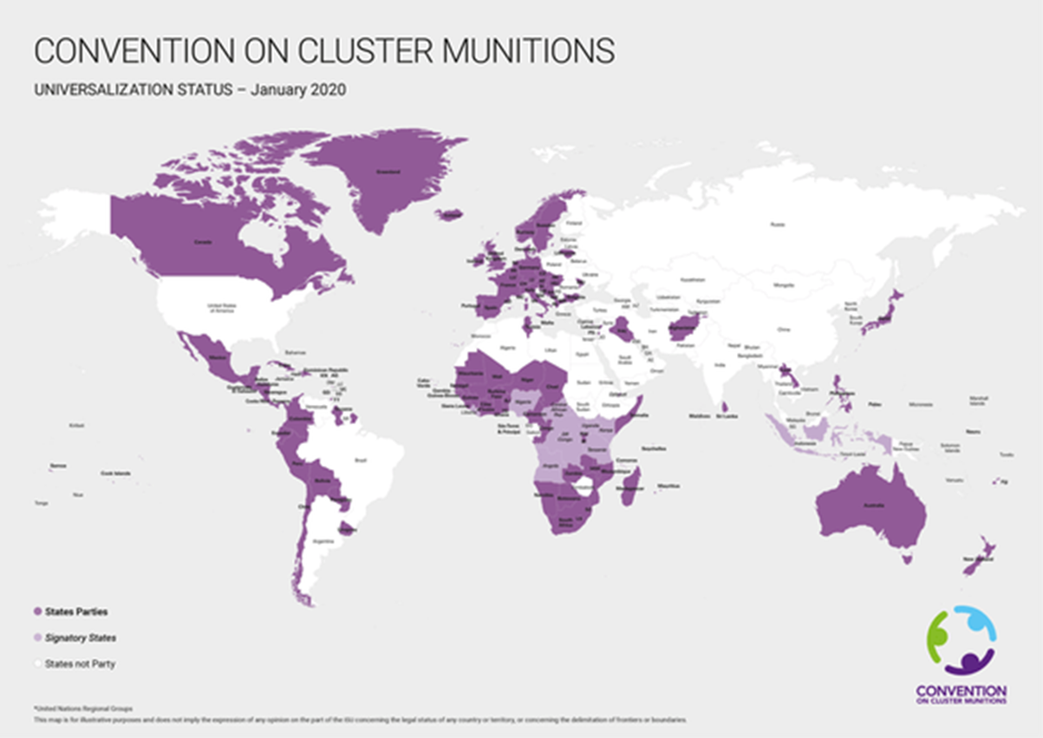
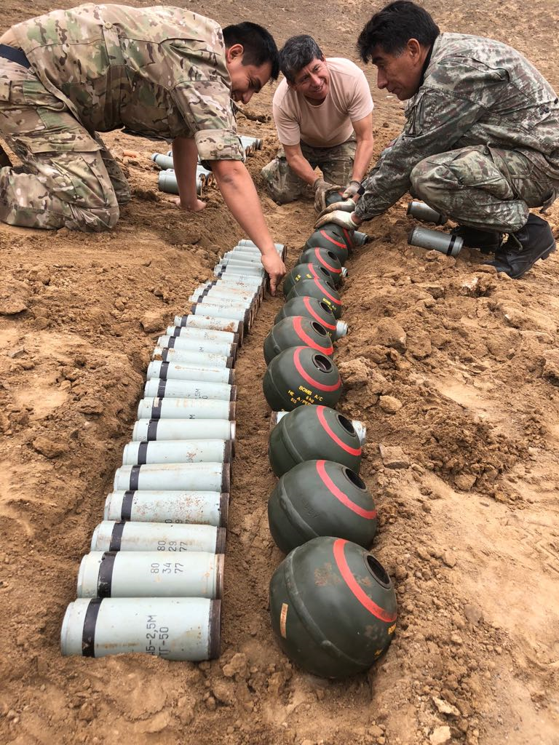
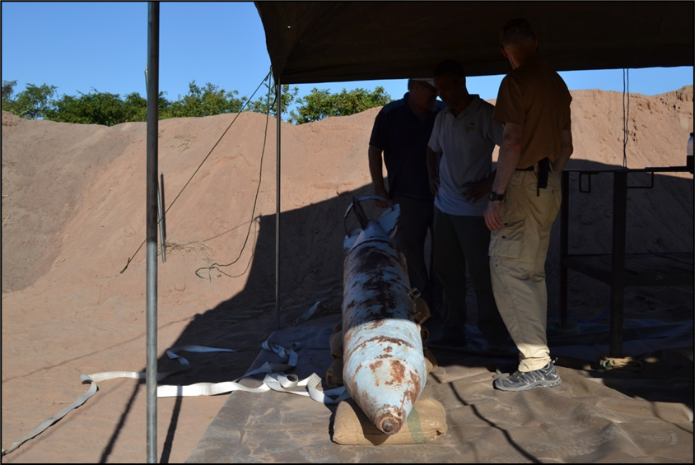
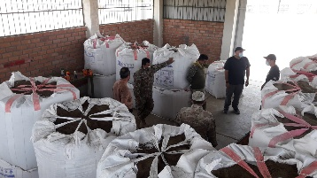
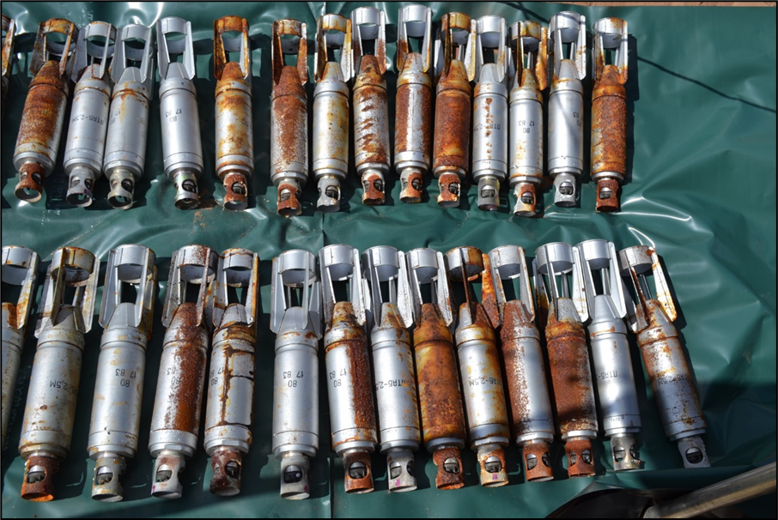
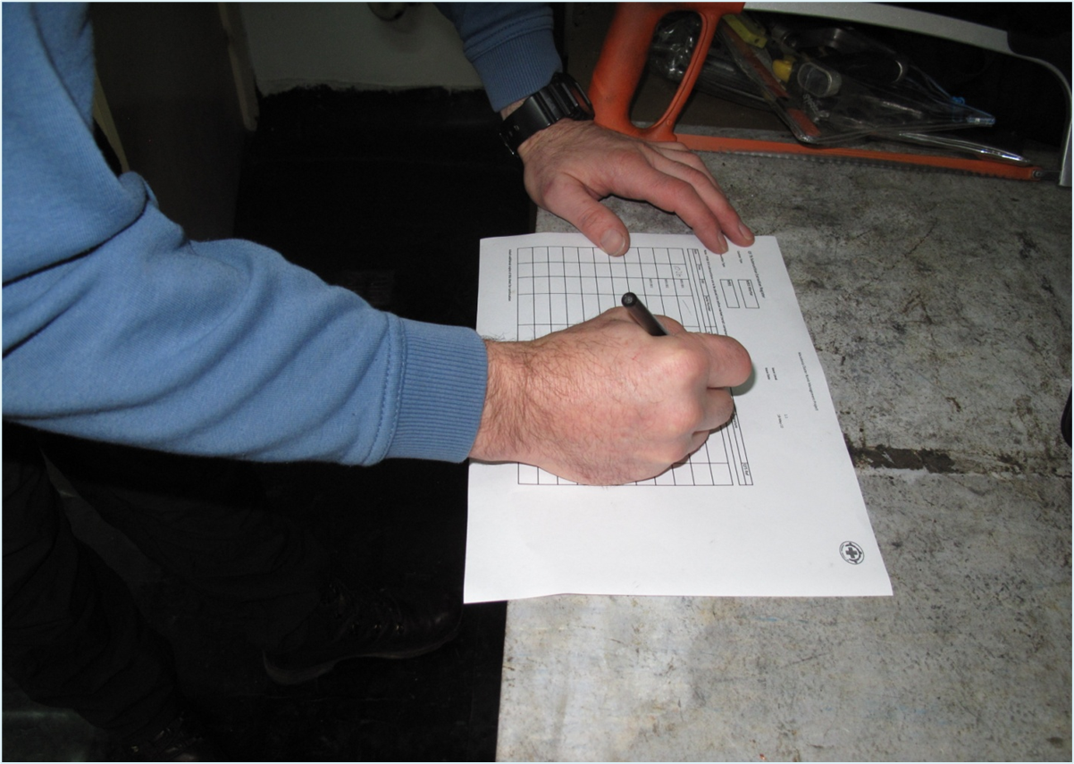
BACKGROUND
CMC PERÚ MILESTONES
Peru core group (Austria, Ireland, Mexico, Norway, New Zealand, Holy See)
108 States parties and 13 signatories
Signature 03/12/2008 Oslo (Norway)
Ratified 26-09-2012
Enters into Force 01/03/2013
2013
2014
2015
2016
2018
2021
2024
07/03/14, Confirmed Norwegian cooperation with Norwegian Peoples's Aid (NPA)
Testing, Configuratión & Logistics,
R&D, Planning & Prep in Detail
Operations
21/09/14 NPA initiates Project Verification and Viability, proposed 8 stages

Slide 5
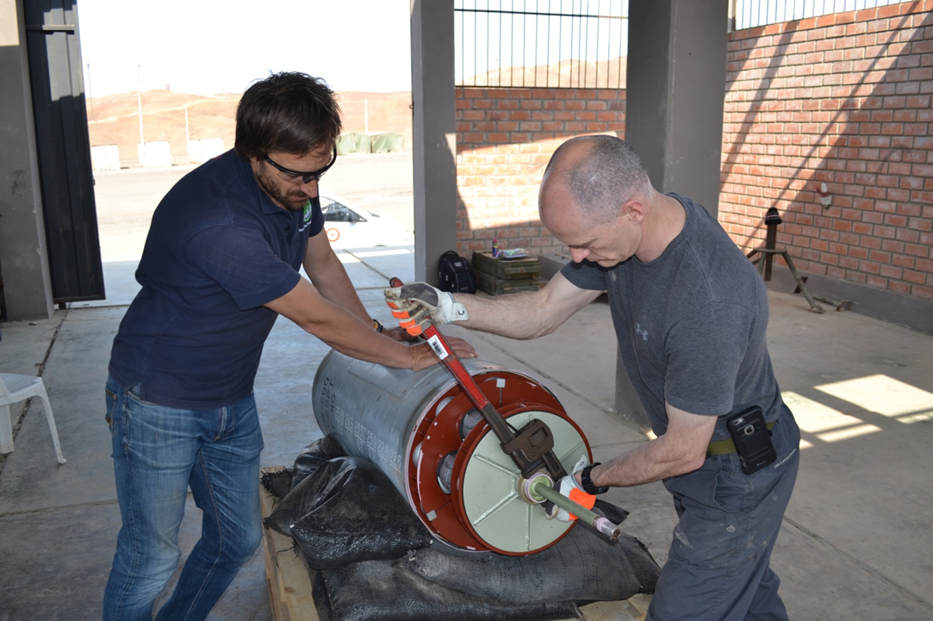
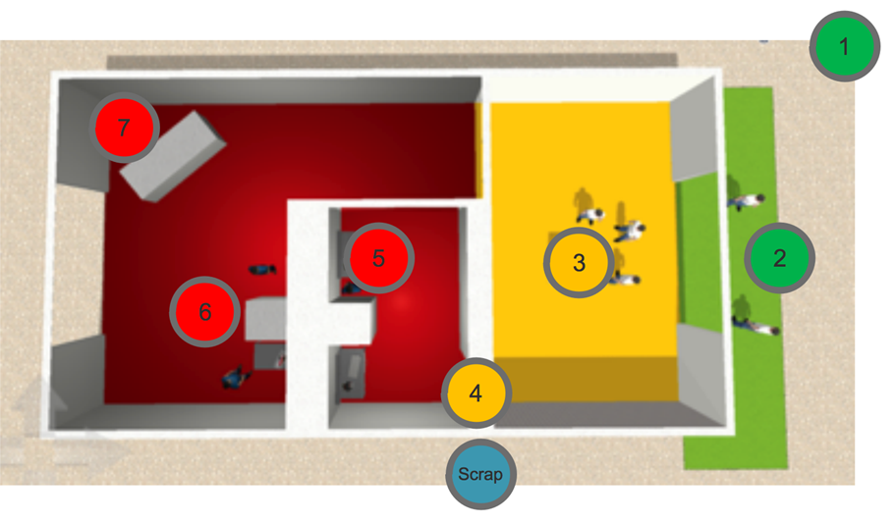
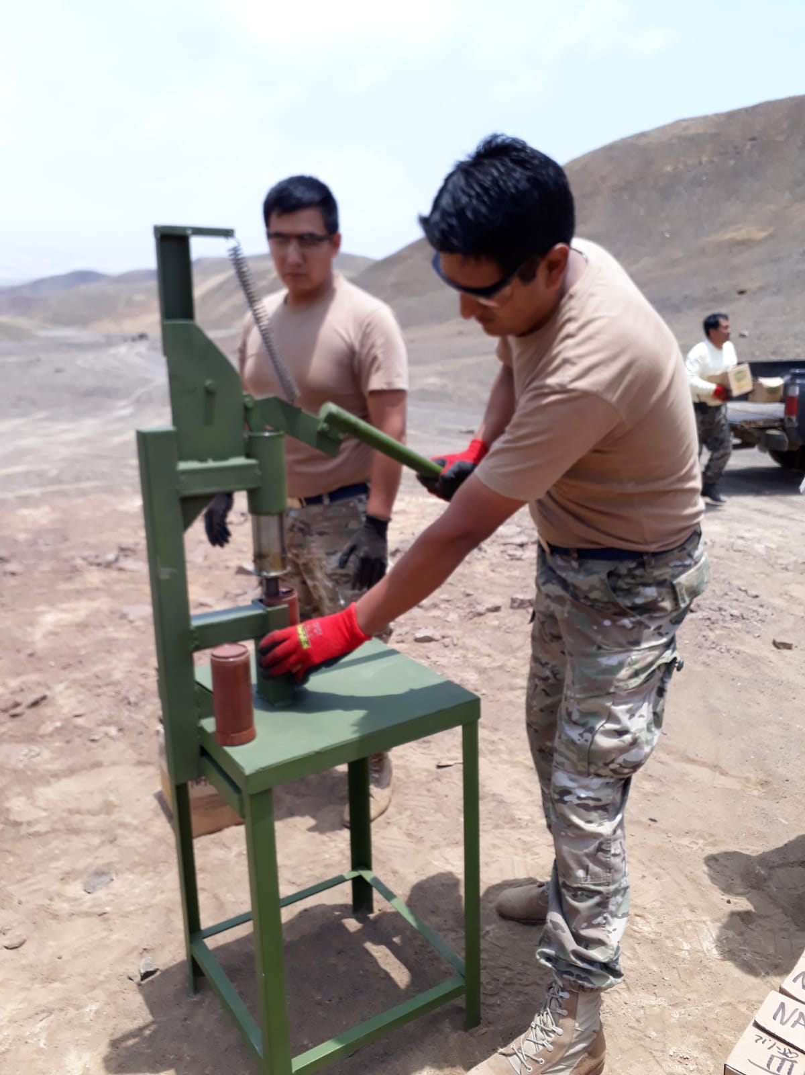
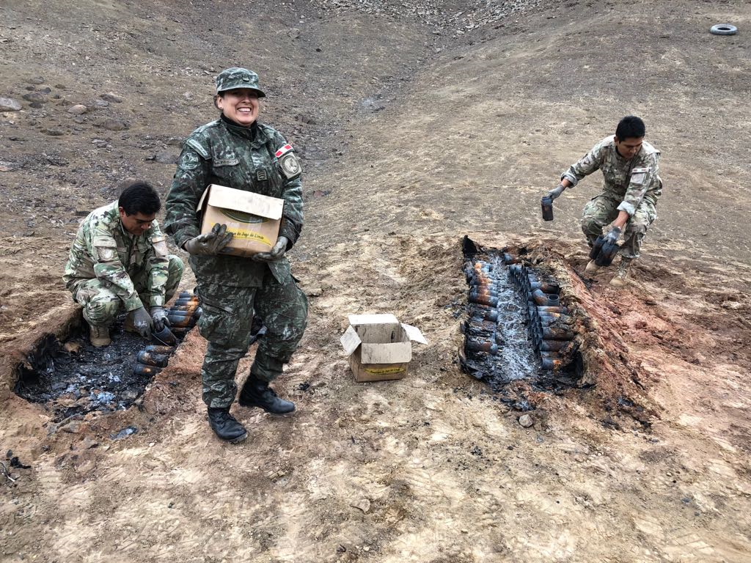
BACKGROUND
CMC NPA Y PERÚ CRONOLOGY
Verification & feasibility (Evaluation)
R&D, Planning & Prep in Detail
Testing, Configuratión & Logistics
Training (22 P)
Operations

Slide 6
BACKGROUND
SCHEDULE PLAN FINAL DISPOSITION FOR CLUSTER MUNITIONS
FAP - NORWEGIAN PEOPLE´S AID (NPA)
ACTIVITIES | 2014 | 2015 | 2016 | 2017 | 2018 | 2019 | 2020 |  | 2021
Verification & feasibility (Evaluation) | 21 – 24 Sep
R&D |  | 04-08 May
Planning & Prep in Detail, |  | 18-19 Aug
Testing, Configuratión & Logistics |  |  | 09-13 May
Training (22 P) Cancelled for “NIÑO FLOODS” |  |  |  | 19-28 Apr
 |  |  |  |  | Jun |  | Nov |  | Jan
Operations |  |  |  |  | 145 CM 290 BMBLTS |  | 805 BMBLTS | 174 CM 680 BMBLTS | --- 6670 BMBLTS
Program closure
2019: IMPROVEMENT OF DIRECTIVA MINDEF 005-2019: STREAMLINE PROCESSING AND
COMPLIANCE WITH FINAL DISPOSAL PROCESSES
2020: WORKS PARALIZED BY THE COVID 19 PANDEMIC

Slide 7
ACHIEVEMENTS
AMOUNT AND TYPE OF CLUSTER MUNITIONS AND SUB EXPLOSIVE AMMUNITIONS DESTROYED DURING THE EIGHT YEARS AFTER THE CONVENTION (01-03-2021)
NOMENCLATURA | AVANCE 2018 | AVANCE 2020 | PENDIENTES 2020 | PENDIENTES 28-02-2021 (CH-SCO)
RBK 500 AO-2,5 RT (60 SUB. MUN. C/U) | 2 |  | 01
RBK 250 PTAP-2,5M (42 SUB. MUN. C/U) | 96 |  | 159
RBK 250 ZAB-2,5 (48 SUB. MUN. C/U) | 44
RBK 250-275 AO-1SCH (150 SUB. MUN. C/U) | 1
BME 330 SNA (180 SUB. MUN. C/U) | 2 |  | 13
BME 330 AR (28 SUB. MUN. C/U) |  |  | 1
BOMBETAS A/C DE 6 KG. S.A. LOTE 1990 | 290 | 805 | 680 | 6670
TOTALES PARCIALES | 435 | 805 | 854 | 6670
TOTAL GENERAL | 435 | 1240 | 2094 | 8764
2020: WORKS PARALIZED BY THE COVID 19 PANDEMIC

Slide 8
ACHIEVEMENTS
AMOUNT AND TYPE OF CLUSTER MUNITIONS AND SUB EXPLOSIVE AMMUNITIONS FOR DESTROYING DURING THE EXTENSION (2021 MAR - 2024 APR)
ETAPA | UNIDAD | NOMENCLATURA | CANT. UNID. | TOTAL UNID. | TOTAL SUB MUN
1RA 2021 | GRUPO AÉREO N°11 (PIURA) | RBK 500 AO-2,5 RT (60 SUB. MUN. C/U) | 45 | 427 | 20,796
 |  | RBK 250 PTAP-2,5M (42 SUB. MUN. C/U) | 84
 |  | RBK 250 ZAB-2,5 (48 SUB. MUN. C/U) | 296
 |  | BME 330 SNA (180 SUB. MUN. C/U) | 2
2DA 2022 | GRUPO AÉREO N°6 (LAMBAYEQUE) | RBK 250 PTAP-2,5M (42 SUB. MUN. C/U) | 21 | 167 | 16,486
 |  | RBK 250 ZAB-2,5 (48 SUB. MUN. C/U) | 16
 |  | RBK 250-275 AO-1SCH (150 SUB. MUN. C/U) | 22
 |  | BME 330 SNA (180 SUB. MUN. C/U) | 56
 |  | BME 330 AP (28 SUB. MUN. C/U) | 52
 |  | Bombas A/C de 6 Kg. S.A. lote 1990 (Sub municiones) | 3,000 |  | 3,000
3RA 2023 | ESCUELA DE FORMACIÓN DE PILOTOS (ICA) | RBK 250 ZAB-2,5 (48 SUB. MUN. C/U) | 114 | 330 | 37,872
 |  | RBK 250-275 AO-1SCH (150 SUB. MUN. C/U) | 216
 |  | Bombas A/C de 6 Kg. S.A. lote 1990 (Sub municiones) | 3,670 |  | 3,670
4TA 2023-24 | GRUPO AÉREO N°2 (AREQUIPA) | RBK 250 PTAP-2,5M (42 SUB. MUN. C/U) | 122 | 282 | 20,148
 |  | RBK 250 ZAB-2,5 (48 SUB. MUN. C/U) | 88
 |  | RBK 250-275 AO-1SCH (150 SUB. MUN. C/U) | 72
 | GRUPO AÉREO N°4 (AREQUIPA) | RBK 500 AO-2,5 RT (60 SUB. MUN. C/U) | 15 | 194 | 11,556
 |  | RBK 250 PTAP-2,5M (42 SUB. MUN. C/U) | 95
 |  | RBK 250 ZAB-2,5 (48 SUB. MUN. C/U) | 62
 |  | RBK 250-275 AO-1SCH (150 SUB. MUN. C/U) | 9
 |  | BME 330 SNA (180 SUB. MUN. C/U) | 13
 |  |  | TOTAL | 1,400 | 113,528

Slide 9
DRAFT PLAN
DRAFT PLAN FINAL DISPOSITION FOR CLUSTER MUNITIONS 2020
N° | TIPO DE MUNICIÓN | CANT. | ENERO |  |  |  | FEBRERO |  |  |  | MARZO |  |  |  | ABRIL |  |  |  | MAYO |  |  |  | JUNIO |  |  |  | SUBT. | TOTAL REST. | UNIDADES
 |  |  | SEMANA |  |  |  | SEMANA |  |  |  | SEMANA |  |  |  | SEMANA |  |  |  | SEMANA |  |  |  | SEMANA |  |  |  |  |  | BAPLO | GRU11 | GRUP6 | EFOPI | GRUP4 | GRUP2
 |  |  | 1 | 2 | 3 | 4 | 1 | 2 | 3 | 4 | 1 | 2 | 3 | 4 | 1 | 2 | 3 | 4 | 1 | 2 | 3 | 4 | 1 | 2 | 3 | 4
7 | Bombas A/C de 6 Kg. S.A. lote 1990 | 8,155 |  |  |  |  |  |  |  |  | 740 | 745 |  |  |  |  |  |  | 500 | 500 | 500 | 500 | 500 | 500 |  |  | 4,485 | 3,670 | 1,485 |  | 3,000
N° | TIPO DE MUNICIÓN | CANT. | JULIO |  |  |  | AGOSTO |  |  |  | SETIEMBRE |  |  |  | OCTUBRE |  |  |  | NOVIEMBRE |  |  |  | DICIEMBRE |  |  |  | SUBT. | TOTAL REST. | UNIDADES
 |  |  | SEMANA |  |  |  | SEMANA |  |  |  | SEMANA |  |  |  | SEMANA |  |  |  | SEMANA |  |  |  | SEMANA |  |  |  |  |  | BAPLO | GRU11 | GRUP6 | EFOPI | GRUP4 | GRUP2
 |  |  | 1 | 2 | 3 | 4 | 1 | 2 | 3 | 4 | 1 | 2 | 3 | 4 | 1 | 2 | 3 | 4 | 1 | 2 | 3 | 4 | 1 | 2 | 3 | 4
1 | RBK-500 AO 2,5 RT | 192 |  |  |  |  |  |  | 3 |  |  |  |  |  |  |  |  |  |  |  |  |  |  |  |  |  | 3 | 189
2 | RBK-250 PTAB 2,5M | 561 |  |  |  |  |  |  | 9 | 25 | 25 | 25 | 25 | 25 | 25 |  |  |  |  |  |  |  |  |  |  |  | 159 | 402 | 75
5 | BME 330 SNA | 86 |  |  |  |  |  |  | 7 | 8 |  |  |  |  |  |  |  |  |  |  |  |  |  |  |  |  | 15 | 71 | 15
6 | BME 330 AR | 53 |  |  |  |  |  |  | 2 |  |  |  |  |  |  |  |  |  |  |  |  |  |  |  |  |  | 2 | 51 | 1
9 | Bombas A/C de 6 Kg. S.A. lote 1990 | 3,670 |  |  |  |  |  |  |  |  | 500 | 500 | 500 | 500 | 500 | 500 | 500 | 170 |  |  |  |  |  |  |  |  | 3,670 | - |  |  |  | 3,670
 | Preparation: training and APB changeover |  |  |  |  |  |  |  |  |  |  |  |  | Working weeks |  |  |  |  |  | Non-working weeks
 |  |  |  |  |  |  |  |  |  |  |  |  |  | Two teams working |  |  |  |  |  | Catch-up time
ONLY REFERENCE (CONSIDER 2021 TO 2024).

Slide 10
DRAFT PLAN FINAL DISPOSITION FOR CLUSTER MUNITIONS 2021
DRAFT PLAN
N° | TIPO DE MUNICIÓN | CANT. | ENERO |  |  |  | FEBRERO |  |  |  | MARZO |  |  |  | ABRIL |  |  |  | MAYO |  |  |  | JUNIO |  |  |  | SUBT. | TOTAL REST. | UNIDADES
 |  |  | SEMANA |  |  |  | SEMANA |  |  |  | SEMANA |  |  |  | SEMANA |  |  |  | SEMANA |  |  |  | SEMANA |  |  |  |  |  | BAPLO | GRU11 | GRUP6 | EFOPI | GRUP4 | GRUP2
 |  |  | 1 | 2 | 3 | 4 | 1 | 2 | 3 | 4 | 1 | 2 | 3 | 4 | 1 | 2 | 3 | 4 | 1 | 2 | 3 | 4 | 1 | 2 | 3 | 4
1 | RBK-500 AO 2,5 RT | 189 |  |  |  |  |  |  |  |  |  |  | 25 | 25 |  | 25 | 25 | 25 | 25 | 24 |  |  |  |  |  |  | 174 | 15 |  | 174
2 | RBK-250 PTAB 2,5M | 402 |  |  |  |  |  |  |  |  |  |  |  |  |  |  |  |  |  |  |  | 25 | 25 | 25 |  |  | 75 | 327
N° | TIPO DE MUNICIÓN | CANT. | JULIO |  |  |  | AGOSTO |  |  |  | SETIEMBRE |  |  |  | OCTUBRE |  |  |  | NOVIEMBRE |  |  |  | DICIEMBRE |  |  |  | SUBT. | TOTAL REST. | UNIDADES
 |  |  | SEMANA |  |  |  | SEMANA |  |  |  | SEMANA |  |  |  | SEMANA |  |  |  | SEMANA |  |  |  | SEMANA |  |  |  |  |  | BAPLO | GRU11 | GRUP6 | EFOPI | GRUP4 | GRUP2
 |  |  | 1 | 2 | 3 | 4 | 1 | 2 | 3 | 4 | 1 | 2 | 3 | 4 | 1 | 2 | 3 | 4 | 1 | 2 | 3 | 4 | 1 | 2 | 3 | 4
2 | RBK-250 PTAB 2,5M | 327 |  |  |  |  | 25 | 25 | 25 | 14 |  |  |  |  |  |  |  |  |  |  |  |  |  |  |  |  | 89 | 238 |  | 125
3 | RBK-250 ZAB 2,5 | 576 |  |  |  |  |  |  |  |  |  | 16 | 25 | 25 | 25 | 25 | 25 | 25 |  |  |  |  |  |  |  |  | 166 | 410 |  | 66
 | Preparation: training and APB changeover |  |  |  |  |  |  |  |  |  |  |  |  | Working weeks |  |  |  |  |  | Non-working weeks
 |  |  |  |  |  |  |  |  |  |  |  |  |  | Two teams working |  |  |  |  |  | Catch-up time

Slide 11
DRAFT PLAN
DRAFT PLAN FINAL DISPOSITION FOR CLUSTER MUNITIONS 2022
N° | TIPO DE MUNICIÓN | CANT. | ENERO |  |  |  | FEBRERO |  |  |  | MARZO |  |  |  | ABRIL |  |  |  | MAYO |  |  |  | JUNIO |  |  |  | SUBT. | TOTAL REST. | UNIDADES
 |  |  | SEMANA |  |  |  | SEMANA |  |  |  | SEMANA |  |  |  | SEMANA |  |  |  | SEMANA |  |  |  | SEMANA |  |  |  |  |  | BAPLO | GRU11 | GRUP6 | EFOPI | GRUP4 | GRUP2
 |  |  | 1 | 2 | 3 | 4 | 1 | 2 | 3 | 4 | 1 | 2 | 3 | 4 | 1 | 2 | 3 | 4 | 1 | 2 | 3 | 4 | 1 | 2 | 3 | 4
3 | RBK-250 ZAB 2,5 | 410 |  |  |  |  |  |  |  |  |  | 26 | 26 | 26 | 26 | 26 |  |  |  |  |  |  |  |  |  |  | 130 | 280 |  | 230
4 | RBK-250-275 AO-1SCH | 388 |  |  |  |  |  |  |  |  |  |  |  |  |  |  |  |  | 25 | 25 | 19 |  |  |  |  |  | 69 | 319 |  | 69
5 | BME 330 SNA | 71 |  |  |  |  |  |  |  |  |  |  |  |  |  |  |  |  | 2 |  |  |  |  |  |  |  | 2 | 69 |  | 2
N° | TIPO DE MUNICIÓN | CANT. | JULIO |  |  |  | AGOSTO |  |  |  | SETIEMBRE |  |  |  | OCTUBRE |  |  |  | NOVIEMBRE |  |  |  | DICIEMBRE |  |  |  | SUBT. | TOTAL REST. | UNIDADES
 |  |  | SEMANA |  |  |  | SEMANA |  |  |  | SEMANA |  |  |  | SEMANA |  |  |  | SEMANA |  |  |  | SEMANA |  |  |  |  |  | BAPLO | GRU11 | GRUP6 | EFOPI | GRUP4 | GRUP2
 |  |  | 1 | 2 | 3 | 4 | 1 | 2 | 3 | 4 | 1 | 2 | 3 | 4 | 1 | 2 | 3 | 4 | 1 | 2 | 3 | 4 | 1 | 2 | 3 | 4
2 | RBK-250 PTAB 2,5M | 238 |  |  |  |  |  |  | 21 |  |  |  |  |  |  |  |  |  |  |  |  |  |  |  |  |  | 21 | 217 |  |  | 21
3 | RBK-250 ZAB 2,5 | 280 |  |  |  |  |  |  |  | 16 |  |  |  |  |  |  |  |  |  |  |  |  |  |  |  |  | 16 | 264 |  |  | 16
4 | RBK-250-275 AO-1SCH | 319 |  |  |  |  |  |  |  |  | 22 |  |  |  |  |  |  |  |  |  |  |  |  |  |  |  | 22 | 297 |  |  | 22
5 | BME 330 SNA | 69 |  |  |  |  |  |  |  |  |  |  | 28 | 28 |  |  |  |  |  |  |  |  |  |  |  |  | 56 | 13 |  |  | 56
6 | BME 330 AR | 51 |  |  |  |  |  |  |  |  |  |  |  |  |  | 26 | 26 |  |  |  |  |  |  |  |  |  | 52 | -1 |  |  | 52
 | Preparation: training and APB changeover |  |  |  |  |  |  |  |  |  |  |  |  | Working weeks |  |  |  |  |  | Non-working weeks
 |  |  |  |  |  |  |  |  |  |  |  |  |  | Two teams working |  |  |  |  |  | Catch-up time

Slide 12
DRAFT PLAN
DRAFT PLAN FINAL DISPOSITION FOR CLUSTER MUNITIONS 2023
N° | TIPO DE MUNICIÓN | CANT. | ENERO |  |  |  | FEBRERO |  |  |  | MARZO |  |  |  | ABRIL |  |  |  | MAYO |  |  |  | JUNIO |  |  |  | SUBT. | TOTAL REST. | UNIDADES
 |  |  | SEMANA |  |  |  | SEMANA |  |  |  | SEMANA |  |  |  | SEMANA |  |  |  | SEMANA |  |  |  | SEMANA |  |  |  |  |  | BAPLO | GRU11 | GRUP6 | EFOPI | GRUP4 | GRUP2
 |  |  | 1 | 2 | 3 | 4 | 1 | 2 | 3 | 4 | 1 | 2 | 3 | 4 | 1 | 2 | 3 | 4 | 1 | 2 | 3 | 4 | 1 | 2 | 3 | 4
3 | RBK-250 ZAB 2,5 | 264 |  |  |  |  |  |  |  |  |  |  | 40 | 40 | 34 |  |  |  |  |  |  |  |  |  |  |  | 114 | 150 |  |  |  | 114
4 | RBK-250-275 AO-1SCH | 297 |  |  |  |  |  |  |  |  |  |  |  |  |  |  |  | 50 | 50 | 50 | 50 | 16 |  |  |  |  | 216 | 81 |  |  |  | 216
N° | TIPO DE MUNICIÓN | CANT. | JULIO |  |  |  | AGOSTO |  |  |  | SETIEMBRE |  |  |  | OCTUBRE |  |  |  | NOVIEMBRE |  |  |  | DICIEMBRE |  |  |  | SUBT. | TOTAL REST. | UNIDADES
 |  |  | SEMANA |  |  |  | SEMANA |  |  |  | SEMANA |  |  |  | SEMANA |  |  |  | SEMANA |  |  |  | SEMANA |  |  |  |  |  | BAPLO | GRU11 | GRUP6 | EFOPI | GRUP4 | GRUP2
 |  |  | 1 | 2 | 3 | 4 | 1 | 2 | 3 | 4 | 1 | 2 | 3 | 4 | 1 | 2 | 3 | 4 | 1 | 2 | 3 | 4 | 1 | 2 | 3 | 4
2 | RBK-250 PTAB 2,5M | 217 |  |  |  |  |  |  |  |  |  |  |  | 50 | 45 | 50 | 50 | 22 |  |  |  |  |  |  |  |  | 217 | - |  |  |  |  | 95 | 122
3 | RBK-250 ZAB 2,5 | 150 |  |  |  |  |  |  | 40 | 22 |  |  |  |  |  |  |  |  |  |  |  |  |  |  |  |  | 62 | 88 |  |  |  |  | 62
4 | RBK-250-275 AO-1SCH | 81 |  |  |  |  |  |  |  | 9 |  |  |  |  |  |  |  |  |  |  |  |  |  |  |  |  | 9 | 72 |  |  |  |  | 9
5 | BME 330 SNA | 13 |  |  |  |  |  |  |  |  |  | 13 |  |  |  |  |  |  |  |  |  |  |  |  |  |  | 13 | - |  |  |  |  | 13
 | Preparation: training and APB changeover |  |  |  |  |  |  |  |  |  |  |  |  | Working weeks |  |  |  |  |  | Non-working weeks
 |  |  |  |  |  |  |  |  |  |  |  |  |  | Two teams working |  |  |  |  |  | Catch-up time

Slide 13
DRAFT PLAN
DRAFT PLAN FINAL DISPOSITION FOR CLUSTER MUNITIONS 2024
N° | TIPO DE MUNICIÓN | CANT. | ENERO |  |  |  | FEBRERO |  |  |  | MARZO |  |  |  | ABRIL |  |  |  | MAYO |  |  |  | JUNIO |  |  |  | SUBT. | TOTAL REST. | UNIDADES
 |  |  | SEMANA |  |  |  | SEMANA |  |  |  | SEMANA |  |  |  | SEMANA |  |  |  | SEMANA |  |  |  | SEMANA |  |  |  |  |  | BAPLO | GRU11 | GRUP6 | EFOPI | GRUP4 | GRUP2
 |  |  | 1 | 2 | 3 | 4 | 1 | 2 | 3 | 4 | 1 | 2 | 3 | 4 | 1 | 2 | 3 | 4 | 1 | 2 | 3 | 4 | 1 | 2 | 3 | 4
3 | RBK-250 ZAB 2,5 | 88 |  |  |  |  |  |  |  |  |  |  | 41 | 41 |  |  |  |  |  |  |  |  |  |  |  |  | 82 | 6 |  |  |  |  |  | 82
4 | RBK-250-275 AO-1SCH | 72 |  |  |  |  |  |  |  |  |  |  |  |  |  | 50 | 22 |  |  |  |  |  |  |  |  |  | 72 | - |  |  |  |  |  | 77
 | Preparation: training and APB changeover |  |  |  |  |  |  |  |  |  |  |  |  | Working weeks |  |  |  |  |  | Non-working weeks
 |  |  |  |  |  |  |  |  |  |  |  |  |  | Two teams working |  |  |  |  |  | Catch-up time

Slide 14
MEASURES TAKEN
IMPROVEMENT OF DIRECTIVA MINDEF 005-2019: STREAMLINE PROCESSING AND COMPLIANCE WITH FINAL DISPOSAL PROCESSES
APPROXIMATE COST: US$ 300,000.00 FOR LOGISTICS AND PAYMENT OF MILITARY SERVICE COMMISSIONS
INVESTMENT PERUVIAN GOVERNMENT FAP: US$ 160,000.00
INVESTMENTS NPA: US$ 140,000.00

Slide 15
CHALLENGES
CONTINUATION OF THE COVID 19 PANDEMIC
FLOODS IN THE FIRST MONTHS DUE TO THE NIÑO PHENOMENON
THE WORKPLACE CHANGE OF MILITARY HAVE ALREADY BEEN TAKEN INTO ACCOUNT AND SOLVED FOR 2021 YEAR.
THE SERVICE COMMISSION AND MATERIAL ACQUISITION PAYMENTS HAVE ALREADY BEEN MADE FOR THE YEAR 2021 AND PLANNED FOR THE FOLLOWING 2022 TO 2024.

Slide 16
WHY THE EXTENSION IS REQUESTED
THE WORK PLAN FOR 37 MONTHS IS IN PLACE
FINANCING IS AVAILABLE.
IT HAS SUPPORT OF ONG NPA (NORWEGIAN PEOPLE´S AIDS)
WORK HAS CONTINUED ON PREVIOUS ACTIONS DESPITE THE COVID 19 PANDEMIC
IT IS A COMMITMENT ASSUMED BY THE PERUVIAN STATE SINCE THE BEGINNING OF THE CCM (CLUSTER MUNITIONS CONVENTION)

Slide 17
Perú CONVENTION ON CLUSTER MUNITIONS ARTICLE 3 EXTENSION REQUEST SUBMITTED BY THE REPUBLIC OF PERÚ
LT COL FAP JHON BONIFAZ ARISTA

Slide 18
GRACIAS

